Slide 1

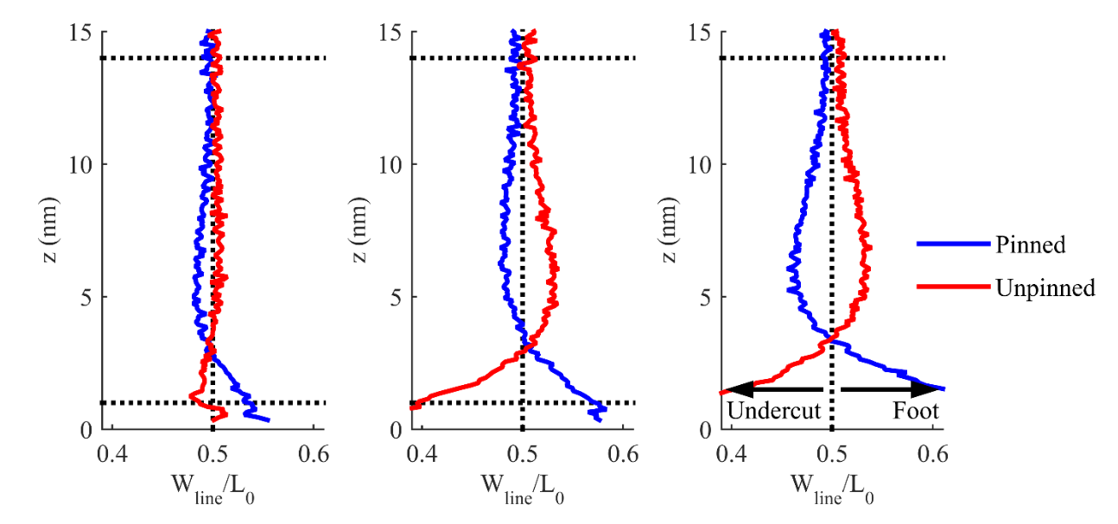
Increasing Line Width

Slide 2
